Slide 1
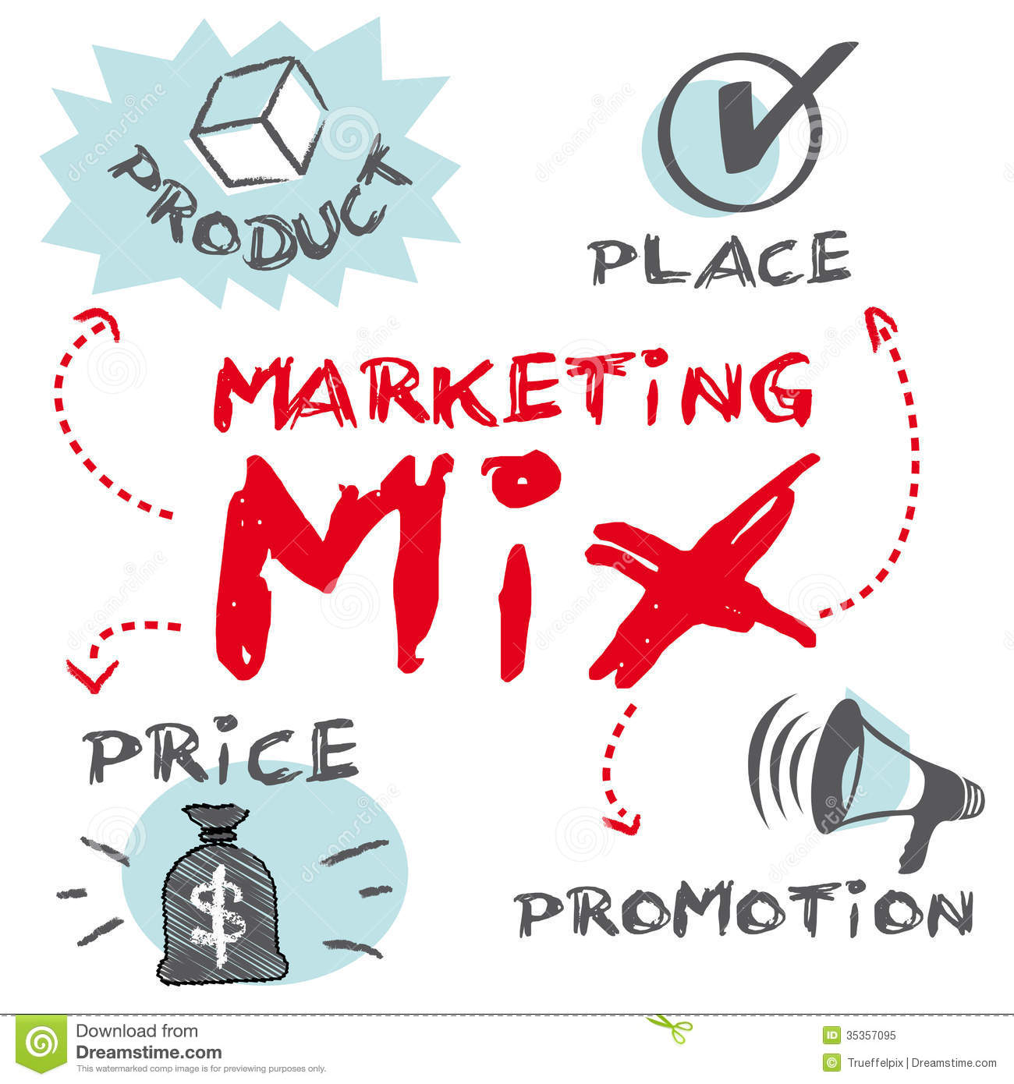
The Four P’s of Marketing

Slide 2

The 4 P’s are:
  Product
  Price
  Promotion
  Place
An Entrepreneur must have an intense understanding of each as it applies to his or her business.
An entrepreneur must also have an intense understanding of how each of these pieces work together.

Slide 3
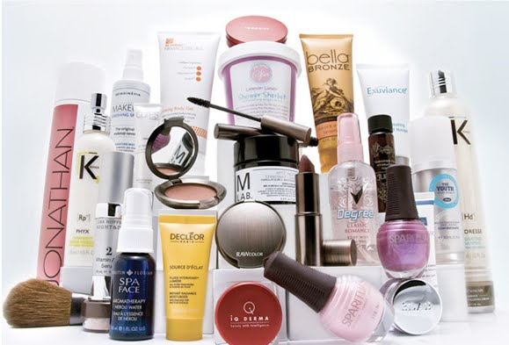
Product /Service
What product or service are you providing?
How is it unique?
How will it benefit customers?
Will it meet a need or want for your customers

Slide 4
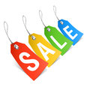
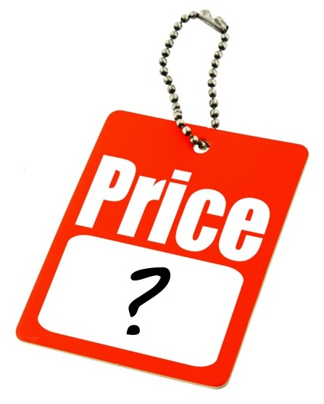

Price
How much will you charge?
How much are customers willing and able to pay?
What does your price include? Warranties, etc.
How much profit do you need/want to make?
It is assumed a profit is to be made.
It includes determining the:
  cost of production (time, labor, ingredients, packaging, advertising, etc)
  the state of supply and demand
  the amount of profit to be made

Slide 5


Promotion
Letting people know about products and services in a positive way so they will want to make a purchase.
Promotion is used to tell potential customers:
  How to use a product or service and what it is used for
  The quality of a product or service
  Where the product or service is available
  New products that are on the market

Slide 6
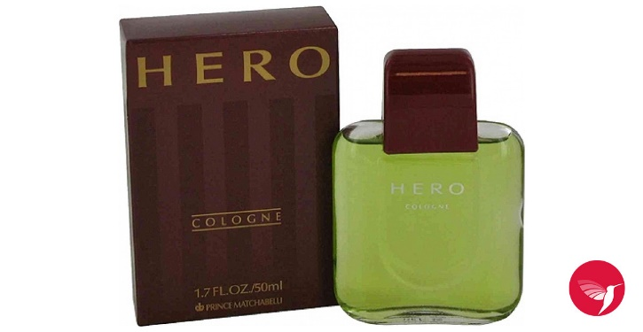

Promotion
How will you let your customers know about your product/service?
What type of promotion will you use?
  Advertising - Any paid form of promotion ( internet, newspapers, TV, radio, magazines, billboards, flyers, etc.)
  Social Media – Instagram, Snap Chat, Facebook, Twitter, TiKToK
  Publicity - Free promotion (press releases or news reports describing how the company sponsored events or donated to a cause.)
  Sales Promotions - Special things done to get customers interested in trying products or to come into a store (coupons, contests, rebates, free samples, displays, etc.)
  Personal Selling

Slide 7
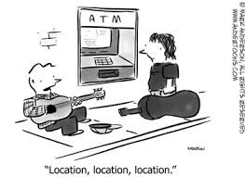
Place
Where will you be located?
How will you receive your products?
Will you sell on the internet?
How will the product or service get to the customers?
You must decide what “channel” you will use to get your product/service to your customers.
The channel is the mechanism through which goods and/or services are moved from the manufacturer/ service provider to the end user or consumer.

Slide 8
Channels of Distribution
Producer
Consumer
Producer
Retailer
Consumer
Importer and or Wholesaler
Producer
Retailer
Consumer
Producer
Specialty Channel
Consumer

Slide 9


Channel #1 Wholesalers
Break down 'bulk' into smaller packages for resale by a retailer.
Provide storage facilities
Take on the some of the marketing responsibilities

Slide 10
Channel #2 Agents
Mainly used in international markets
Agent will typically secure an order for a producer and will take a commission

Slide 11

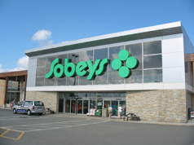
Channel #3 Retailers
Retailers will have a much stronger personal relationship with the consumer.
The retailer will hold several other brands and products. A consumer will expect to be exposed to many products
The retailer will give the final selling price to the product.
Retailers often have a strong 'brand' themselves

Slide 12

Channel #4 Internet
The main benefit of the Internet is that products reach a wider audience
Start-up costs are low.
Use e-commerce technology (for payment, shopping software, etc)

Slide 13
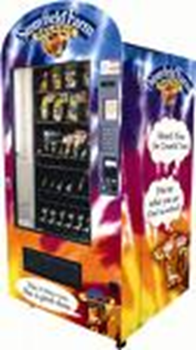
Specialty Channels
Vending Machines
Catalogues
Telemarketing
TV (The Shopping Network)
The Internet
  The main benefit of the Internet is that products reach a wider audience
  Start-up costs are low.

Slide 14

Pricing Strategies

Slide 15
Pricing High
Setting an initially high price for a product or service before competitors enter the market.
Referred to as Market Skimming
Use when there is little or no competition.
Used a lot in the tech industry
Companies can reach the break-even point quickly and recover development costs, therefore able to lower the price if competitors enter the market.

Slide 16
Pricing Low
Pricing lower than your competitors
Referred to as Penetration Pricing
Effective, but risky
Use this strategy when variable cost are low.
Pricing the Same
Referred to as Competitive Pricing
Matching or coming close to the competitor’s price.
The battle for market share is fought with advertising, promotion, a unique product feature or unique distribution method.

Slide 17
Psychological Pricing
Prices are set to give the impression that they are less than they actually are.
  299.99 vs. 300.00
  Loss-Leader Pricing
  Selected products / services are sold at less than cost to attract customers who will then make other purchases to compensate for the loss of profits.
  Multiple-Unit Pricing
  Items priced in multiples to suggest a bargain and to increase sales volume. ( 3 for $1.00.)

Slide 18
Cost-Based Pricing Method
Utilizes cost + Mark-up ($ or %)
Cost + $ Mark-up = Price
($500 sofa + $300 Mark-up = $800
This method is best used for: services, high price/luxury items, i.e. cars, furniture
Cost + % Mark-up =Price
($50 muffler + 60% Mark-up = $80
$50 X .60 = $30
$50 + $30 = $80
This method is best used for a lot of different product/services i.e. convenience store, auto parts store.

Slide 19
Pricing Methods You Cannot Use
Price and the Law
The Canadian Competition Act protects consumers from the following practices.

Slide 20
Price Fixing - businesses are not allowed to decide as a group what to charge consumers for a specific product.
Retail Price Management – no company can force another independent company to charge a price for a product it has provided. A company can suggest a price (Manufacturer’s Suggested Retail Price - MSRP)
Deceptive Pricing Strategies:
Double Ticketing - refers to the placing of two prices on the same product and charging the customer the higher price.
Bait and Switch - occurs when a product is advertised at a low price to attract (bait) customers then the sales staff tries to disparage the customer in order to get the customer to buy a more expensive item.
False Sale Price - refers to the practice by some stores of advertising a regular price as a sale price.

